Slide 1


From Free-Text Follow-up Notes to Structured Actions
Extracting clinical instructions and timeframes Models in a controlled mini-world.

Slide 2







Motivating Use Case
The Need
The Value
Current State
Doctors write free-text instructions (e.g., "Do blood test in 2 weeks"). Systems need to know what action and when it's due for every patient.
Structured data allows for automatic compliance checks ("Did the patient do the test?"), overdue alerts, and population health dashboards.
Instructions remain locked in text notes. Verification requires manual chart review. Existing tools often ignore these crucial instructional nuances.

Slide 3
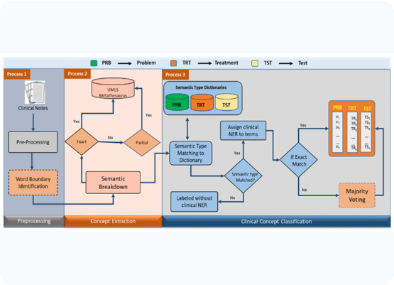
Project Task: Instruction Extraction
•
Input: A synthetic clinical note containing symptoms, history, and 1–3 natural language instructions (e.g., "Come back in 4 weeks").
•
Output: For a fixed library of actions, predict:
○
Present (True/False)
○
Timeframe (Days)
•
Novelty: Focus specifically on the "Action + Timeframe" extraction task using a controlled "mini-world" with perfect ground truth.

Slide 4
Synthetic Data Generation
Closed Instruction Library
We define a fixed set of actions (CBC, X-Ray, Glucose Log) to constrain the problem space.
Generative Process
We sample instructions first, then ask an LLM to "weave" them into a realistic clinical narrative. This ensures we have perfect ground truth labels for training and evaluation.
Why Synthetic?
It eliminates privacy concerns and removes human annotation error, allowing us to focus purely on the extraction capability of the NLP models.

Slide 5
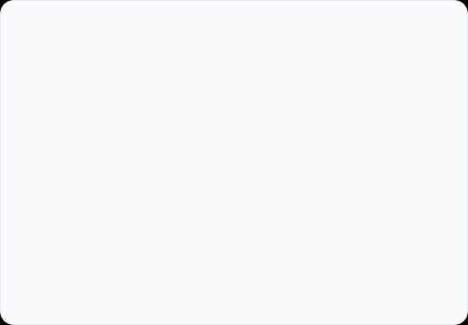
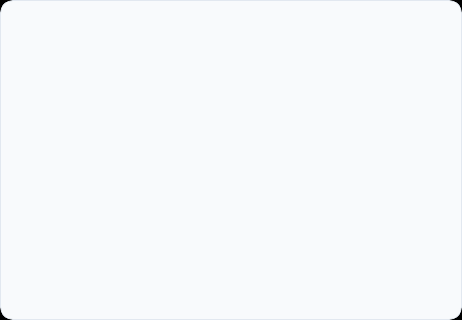
Models & Methods: Baseline vs. Pipeline
(A) Baseline Approach
(B) Structured Pipeline
Free-form JSON List
Per-Code Checklist
The model reads the note and simply lists whatever actions it finds.
The model is forced to make a binary decision for every code in the library.
•
"List instructions found..."
•
"For code CHEST_XRAY: Is it present?"
•
Risk of hallucination or omission.
•
Explicit decision making.
•
Requires post-processing to map back to the library.
•
Produces a complete, structured matrix directly.

Slide 6
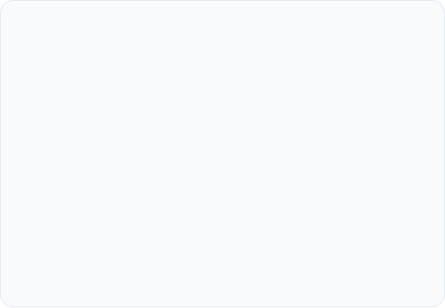
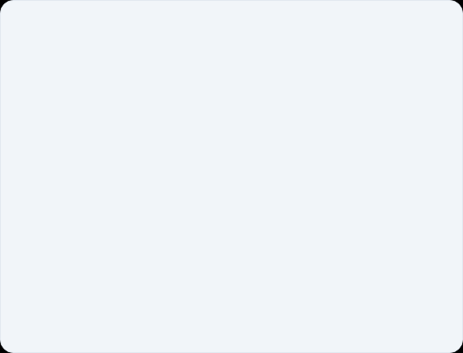


Example Extraction
Synthetic Clinical Note
Structured Output
GROUND TRUTH
"The patient presents for an outpatient visit with 3 weeks of intermittent headaches... Past medical history is notable for well-controlled hypertension... Assessment: primary headache disorder is most likely...
Plan: advise nonpharmacologic measures... Please schedule a follow-up visit with the same physician in 4 weeks to reassess symptoms and review any test results."
MODEL PREDICTIONS
Baseline ✔ 28 Days
Pipeline ✔ 28 Days

Slide 7
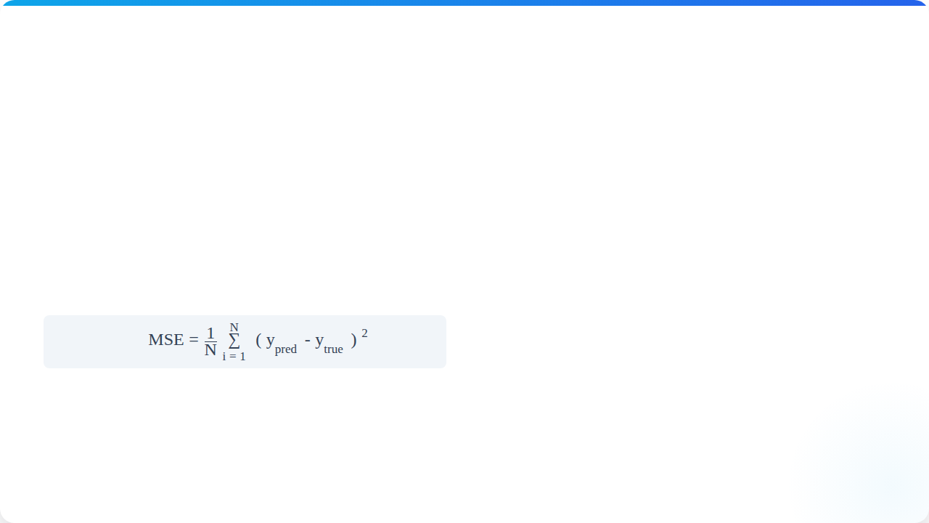

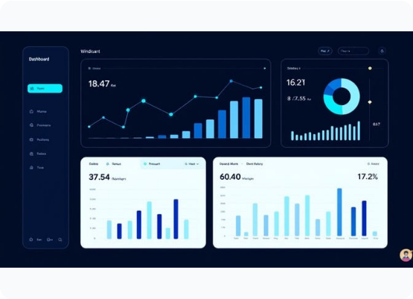
Metrics & KPIs
1. Instruction Detection
Did the model find the right action? Measured via Accuracy and F1-Score on the binary present label.
2. Timeframe Quality
If the action was found, did the model understand "2 weeks" = 14 days? Measured via Mean Squared Error (MSE):
3. Comparison
Does the structured pipeline offer more consistent detection and accurate timeframes compared to the baseline?

